Slide 1
Recurrent Networks

Slide 2
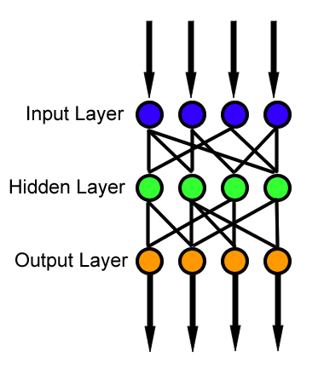

Slide 3

Types of mapping tasks

Slide 4
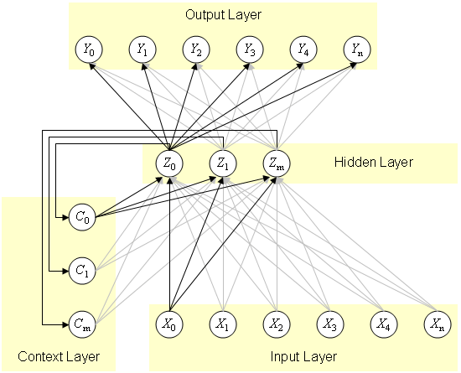
Elman network

Slide 5
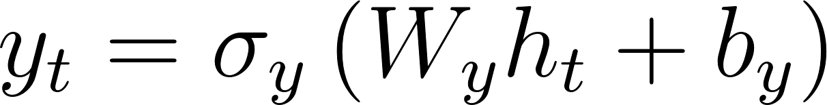
Elman network
Jordan network

Slide 6
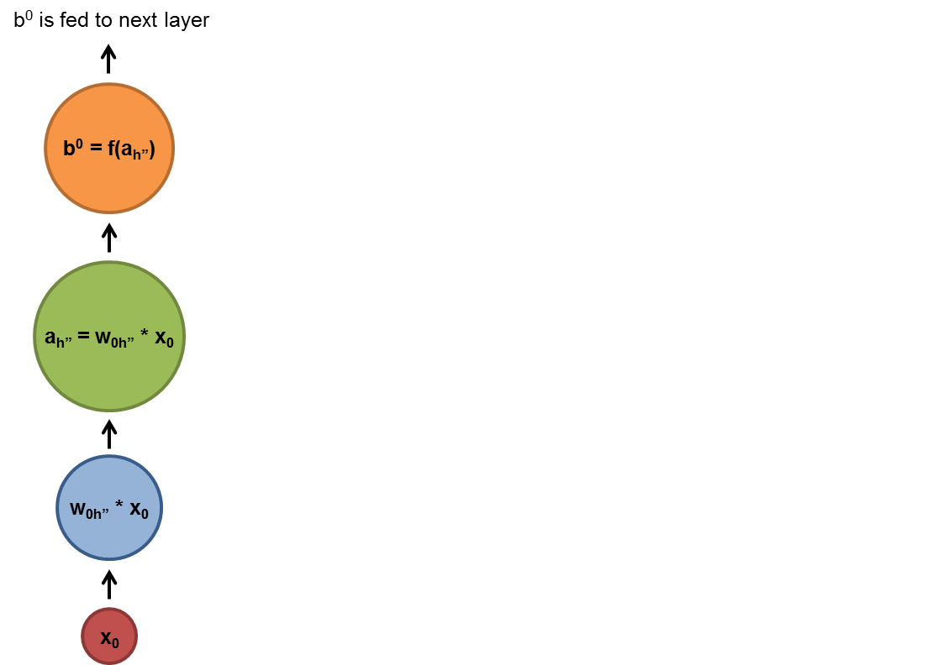
RNN idea

Slide 7
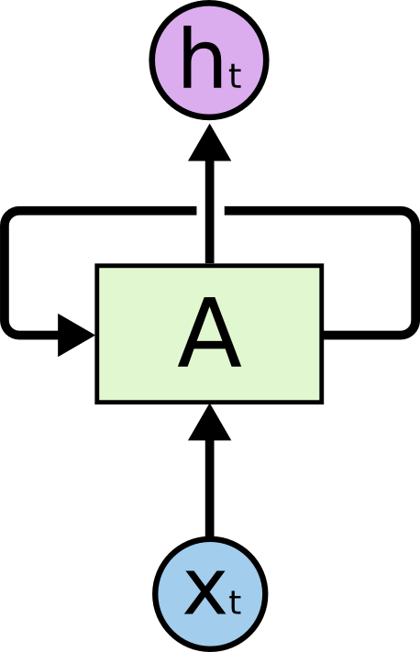
RNN idea

Slide 8

RNN idea

Slide 9
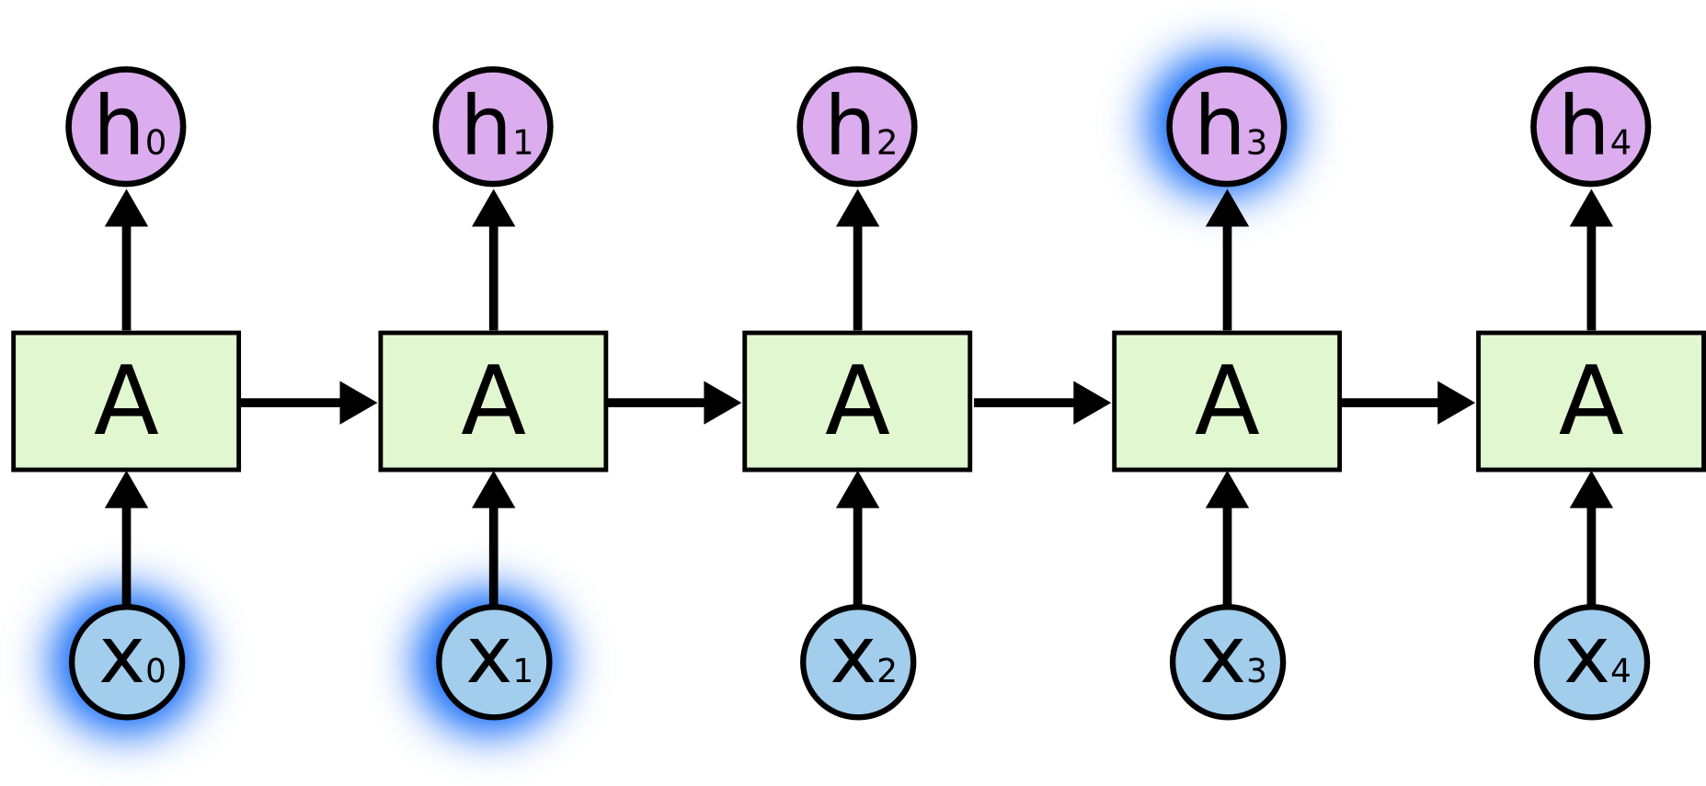
Short term dependencies

Slide 10
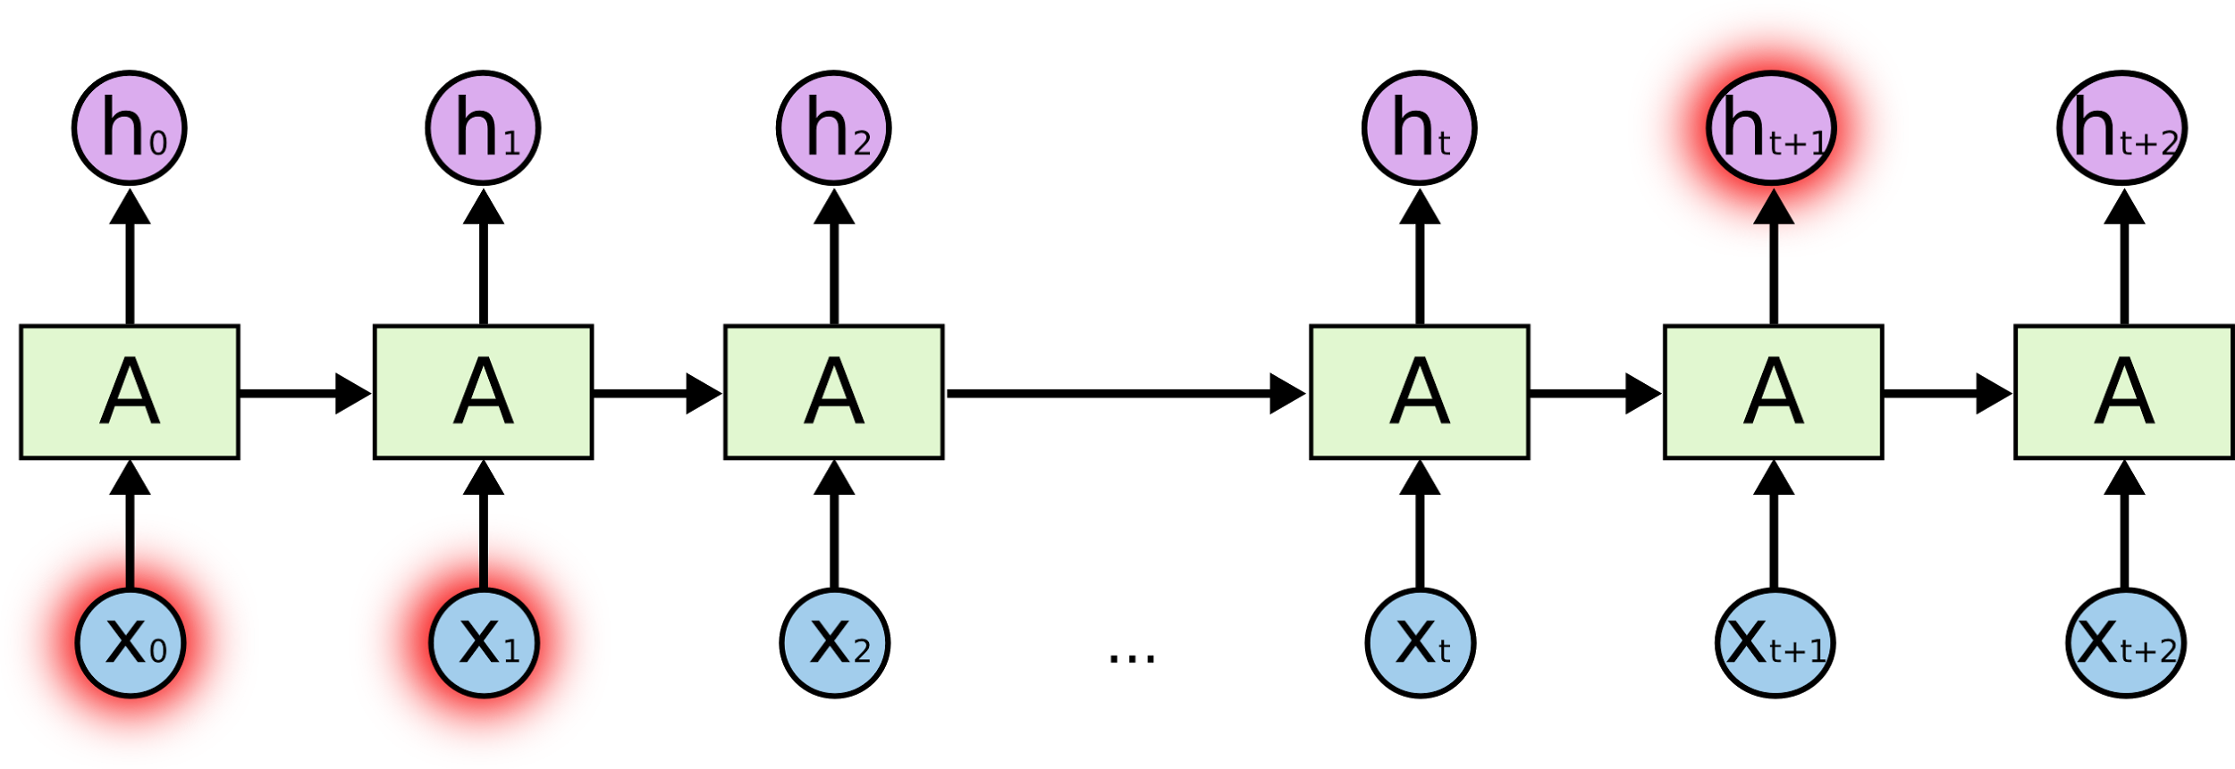
Long term dependencies

Slide 11
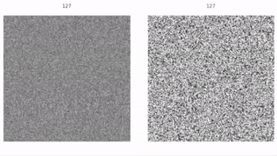
Vanishing gradients

Slide 12

Simple RNN

Slide 13


LSTM

Slide 14
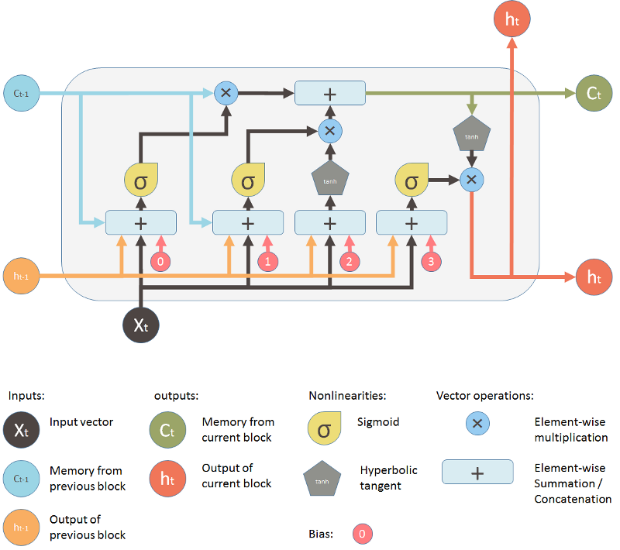
LSTM

Slide 15

LSTM

Slide 16
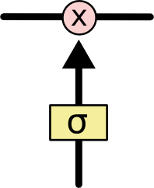
LSTM: gate

Slide 17

LSTM: forget gate

Slide 18

LSTM: input gate

Slide 19

LSTM: memory update

Slide 20

LSTM: update

Slide 21
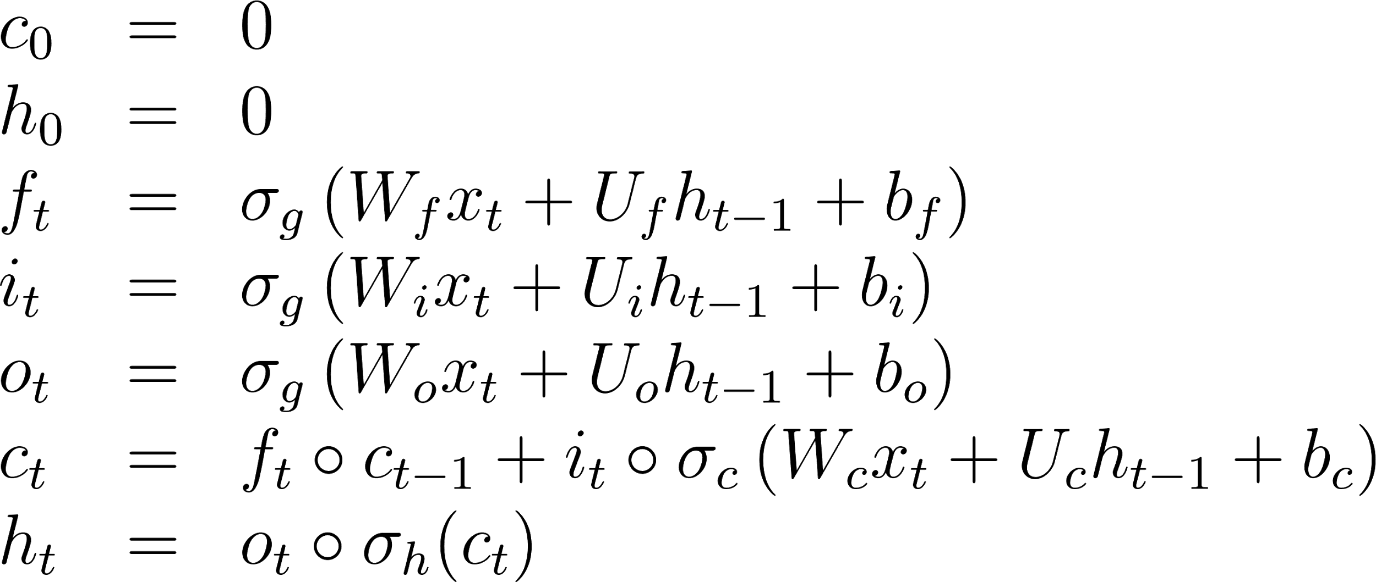
LSTM
forget gate
input gate
output candidate gate
inner state
output

Slide 22

GRU

Slide 23
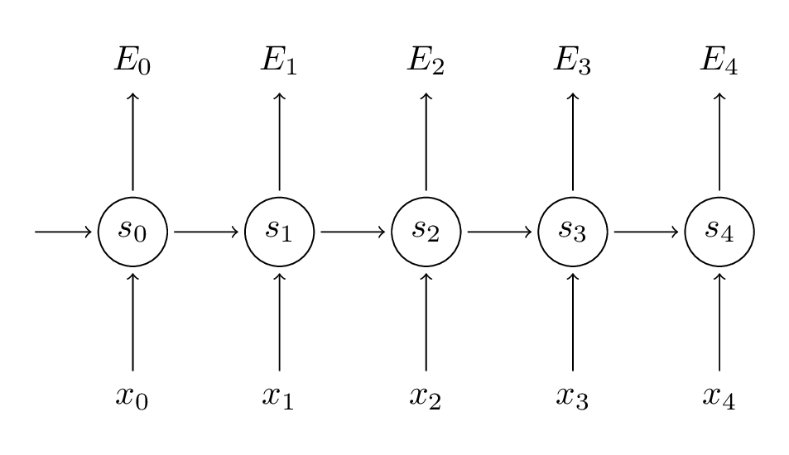
forward

Slide 24
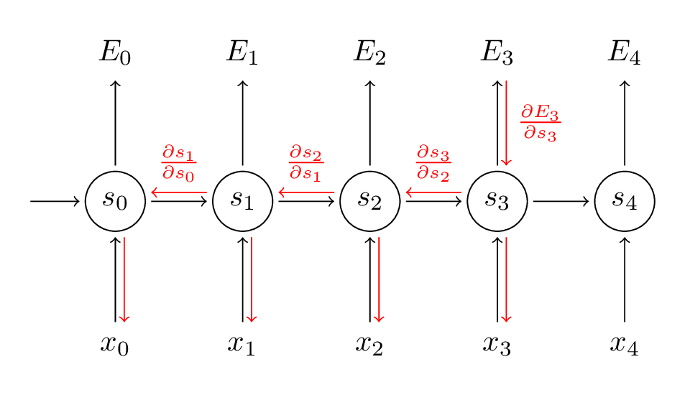
backward

Slide 25
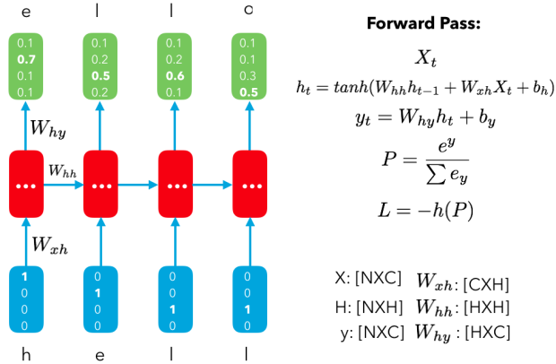
char-rnn

Slide 26
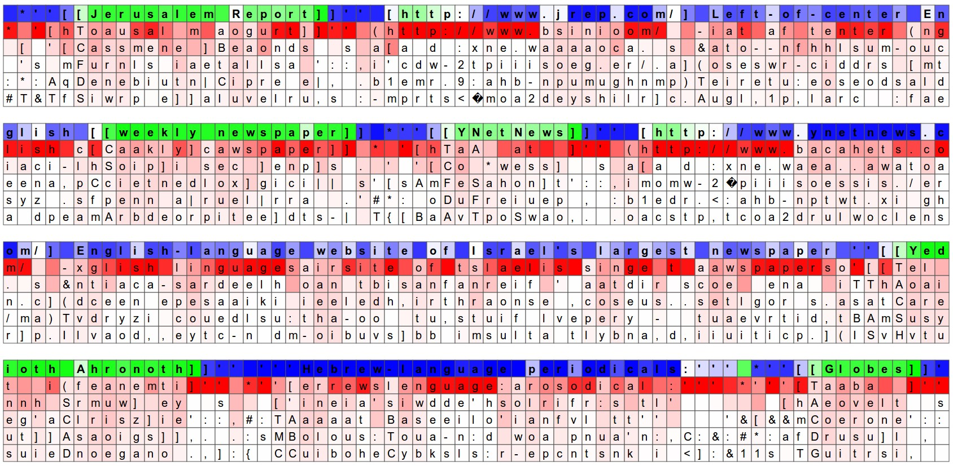
char-rnn

Slide 27
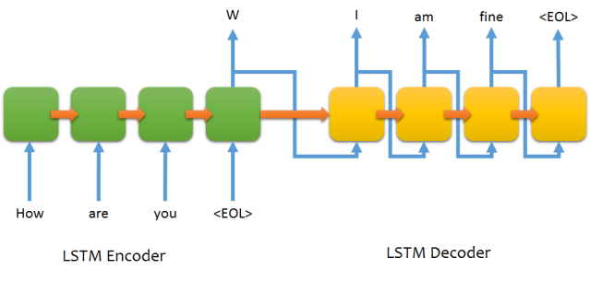
Seq2seq

Slide 28
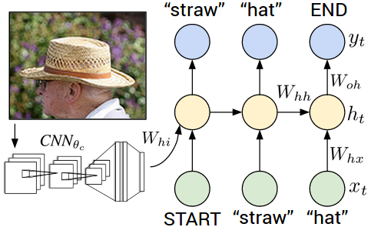
Image captioning

Slide 29
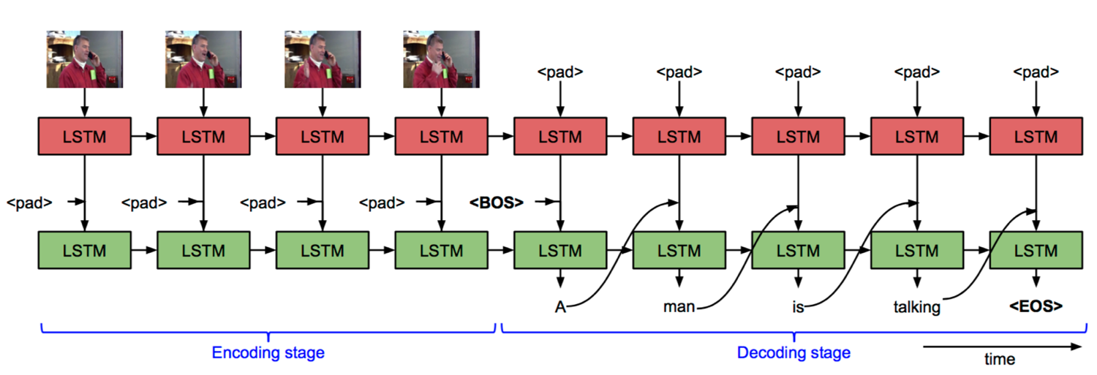
Image captioning

Slide 30



Slide 31
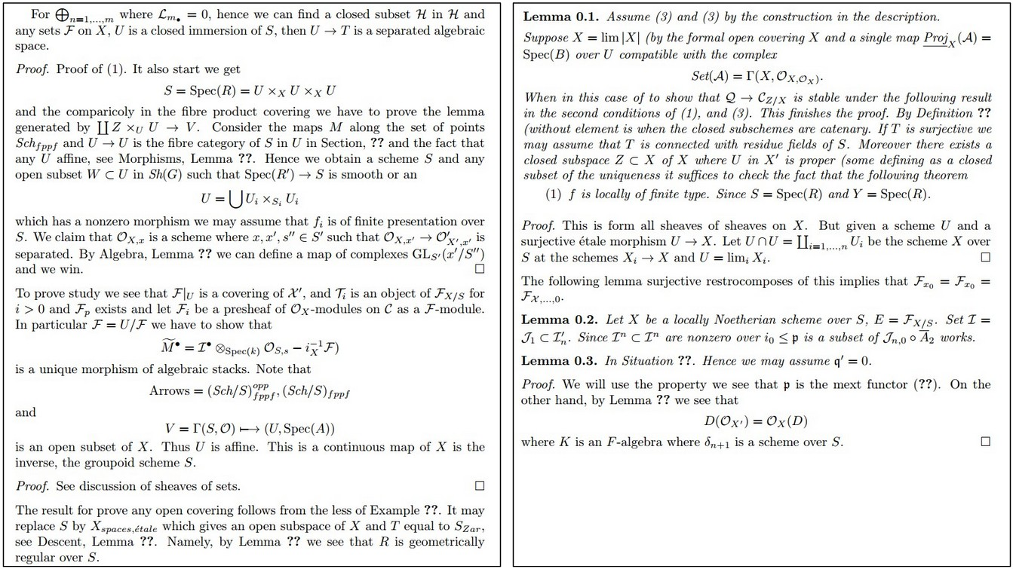

Slide 32
